Slide 1

Claims Expenditure & Premium Data Reporting
BIANNUAL WEBFORM SUBMISSION

Slide 2

Claims Expenditure & Premium Data Reporting
Objectives
Overview
User permissions
Notifications
Navigation
Submission
Verification
At the completion of this module, training participants will be able to complete their biannual Claims Expenditure and Premium Data reporting.
Notes:
TIP: Use this slide as the 2nd slide in each Module deck. If the module is broken down into sub-sections, then use this slide after each Section Divider.

Slide 3
Insurer Claims Expenditures & Premium Data Webform
OVERVIEW
The Insurer Claims Expenditures & Premium Data Webform provides a way for insurers and TPAs to submit bi-annual claims expenditure and premium data for the purpose of calculating assessments. Some things to note about the webform:
Data call windows open twice a year to collect expenditure data over a six-month period
  Data collected for the July-December period is collected from January 31st – February 28th
  Data collected for the January-June period is collected from July 31st – August 31st
Verification period opens at the end of the year, allowing users to validate the previous fiscal year’s data prior to the assessment calculations. The verification window is open from October 31st – January 1st
The webform collects claims expenditure and earned premium data, categorized between mining and non-mining data
TPAs can only enter claims expenditure and premium data as a registered user of the insurer they are associated with

Slide 4
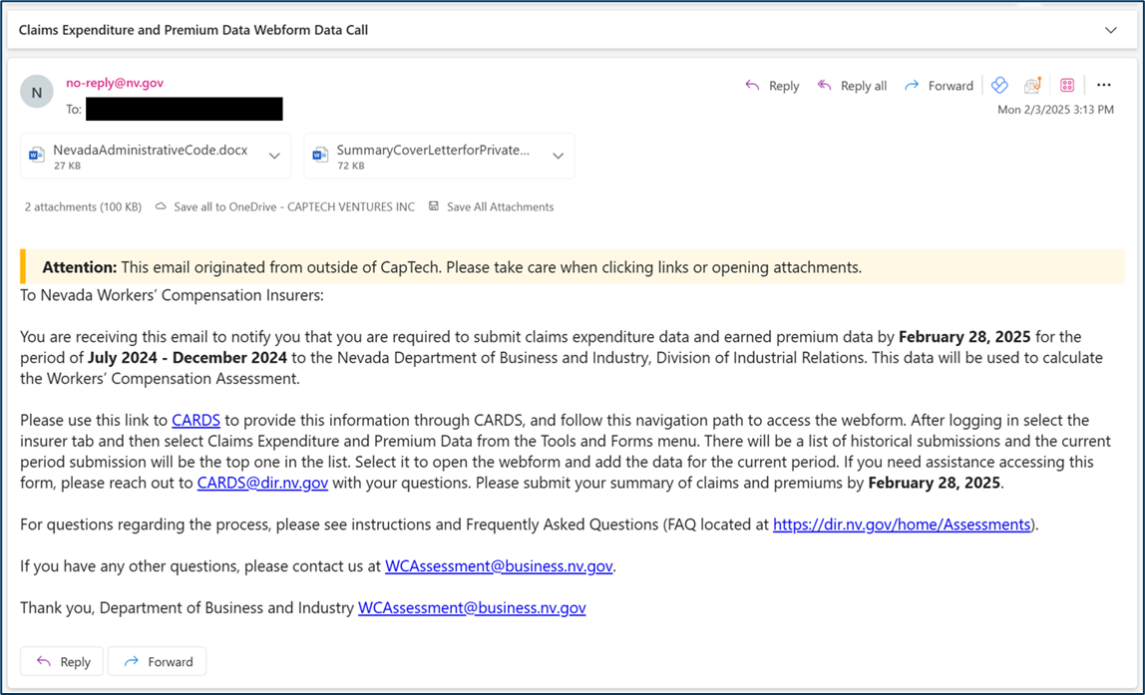
Request for Data Email
When the Claims Expenditure and Premium Data webforms become available, either on January 31st or July 31st, insurers will be notified via email to submit the claims expenditure and earned premium data.

Slide 5
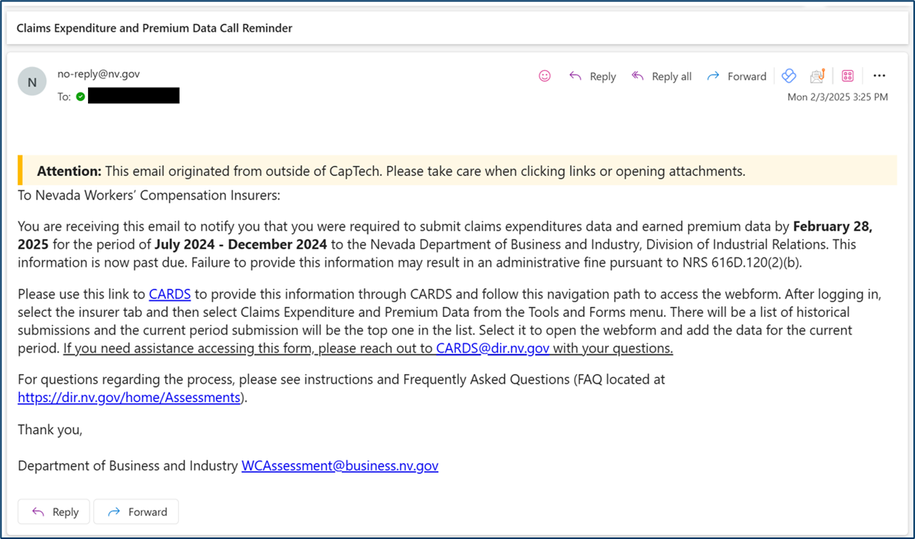
Request for Submission Reminder Email
If an insurer has not submitted the webform when the data call window is active, a reminder will be sent to the insurer 30 days and 45 days after the initiation of the data call window.

Slide 6
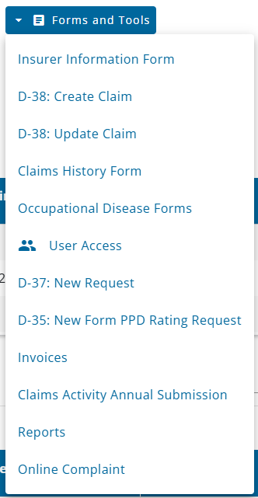
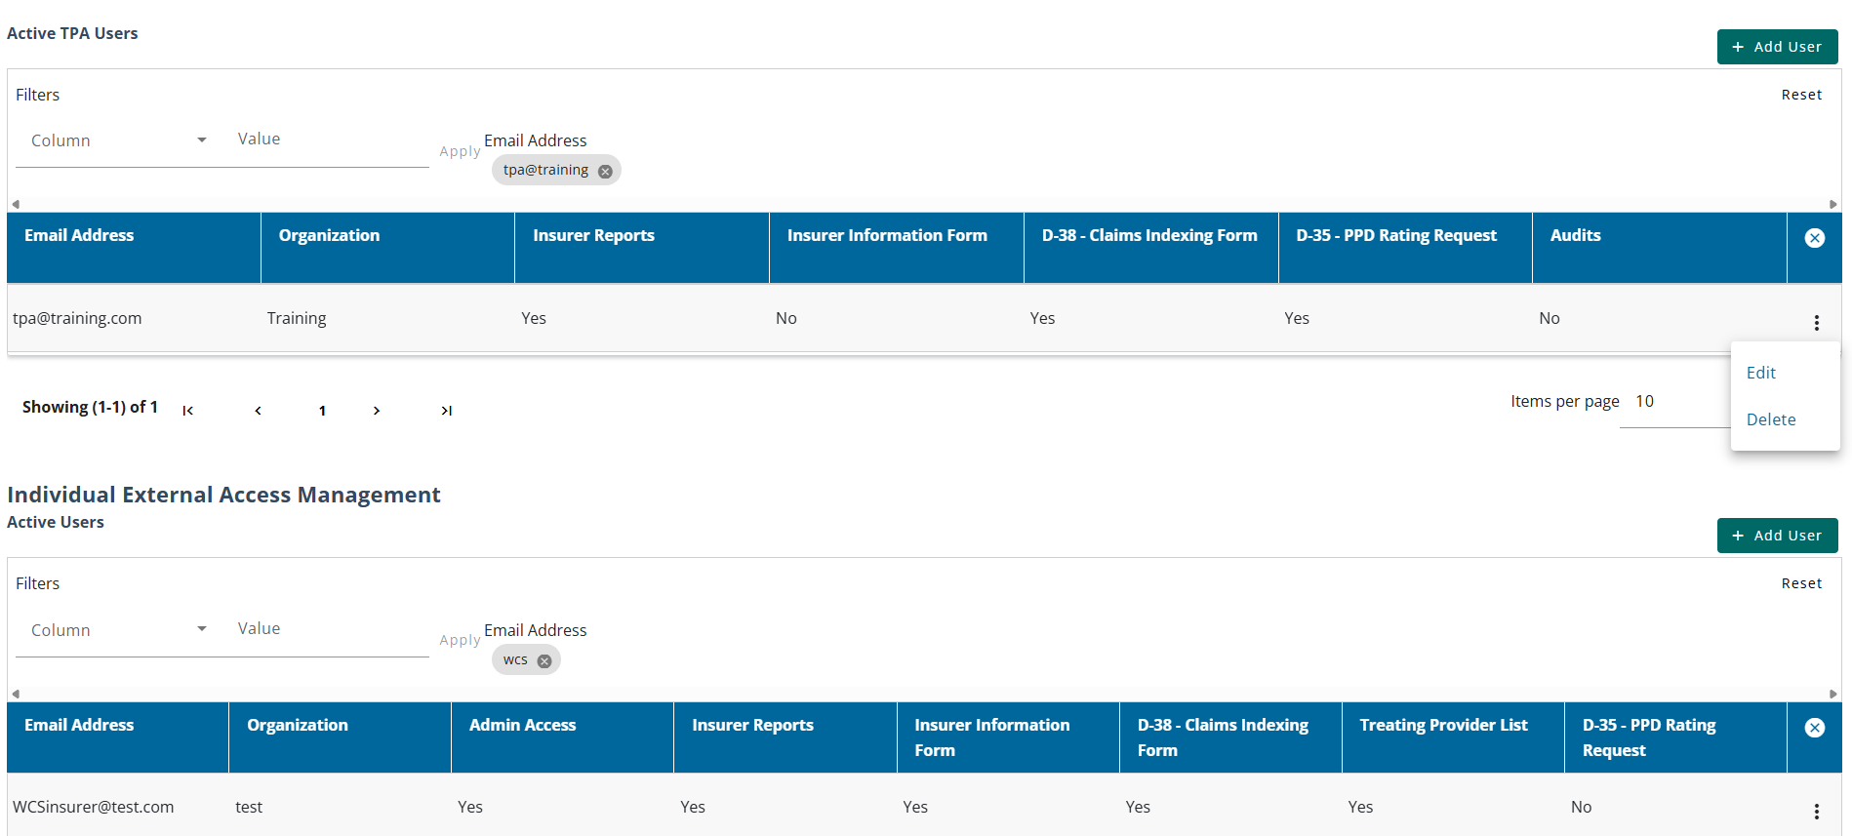
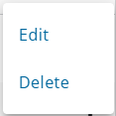
Permissions
ACCESS TO THE CLAIMS EXPENDITURES & PREMIUM DATAWEBFORM
Insurer users with admin access can grant the Claims Expenditure and Premium Data permission to give access to the webform. Permissions can be set from the User Access Management page available from the Forms and Tools menu.
Ellipsis provides the edit options and/or delete users

Slide 7
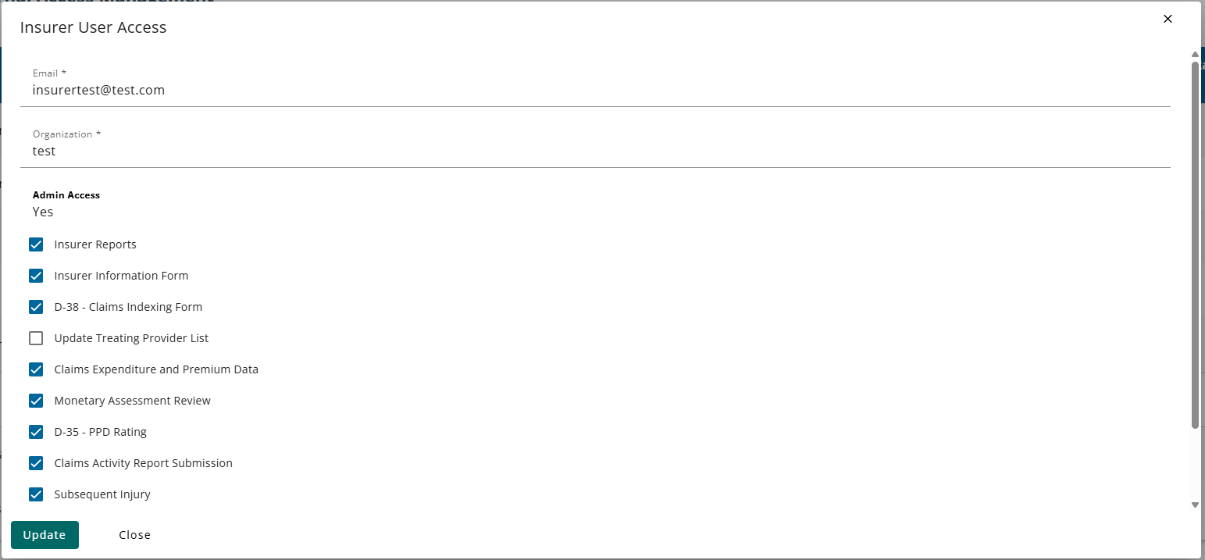
Setting Permissions for an Insurer User
The insurer admin can then select the permissions they wish to provide.
Notes:
Note: Most of the user management access pages are currently not appropriate to show in their entirety as they contain active personal email addresses. Trainers may verbally elaborate on the User Access Management page as well as refer to the CARDS 101 training for additional information.

Slide 8
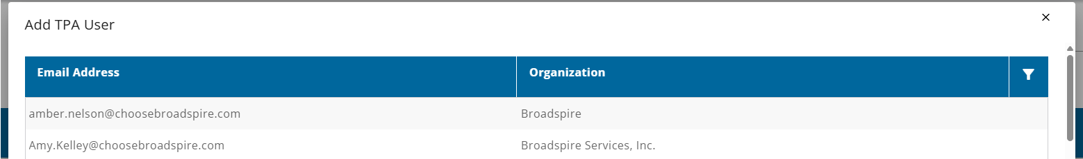
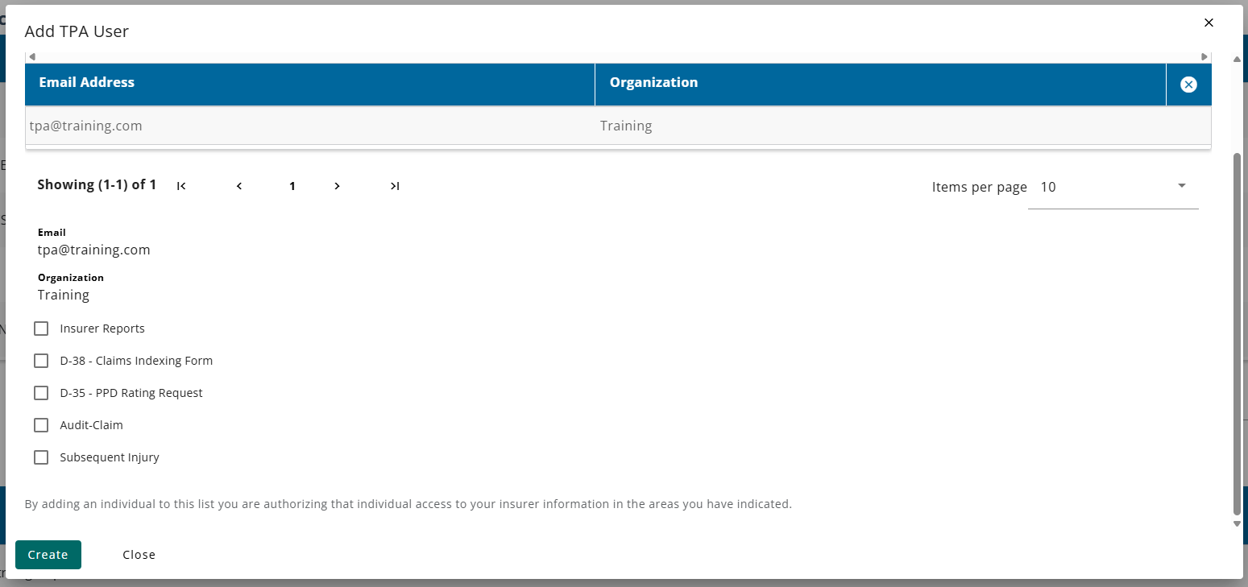
Adding and Selection Permissions for a TPA User
TPA users that belong to the related TPA groups can be selected as authorized users by the Insurer group. Once the insurer admin has selected the user, the available permissions can be provided.
Notes:
Note: Most of the user management access pages are currently not appropriate to show in their entirety as they contain active personal email addresses. Trainers may verbally elaborate on the User Access Management page as well as refer to the CARDS 101 training for additional information.

Slide 9
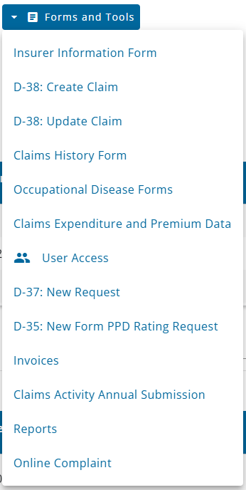
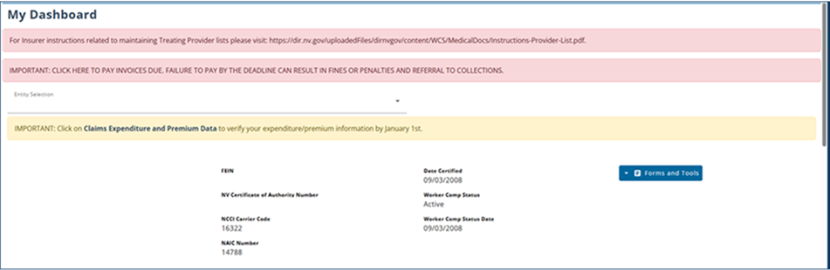
Navigation
Once the permissions have been set and the webform is active for a given data call, users can navigate to the webform in two ways: through the Forms and Tools menu, or from the reminder banner if it is during a submission window.

Slide 10
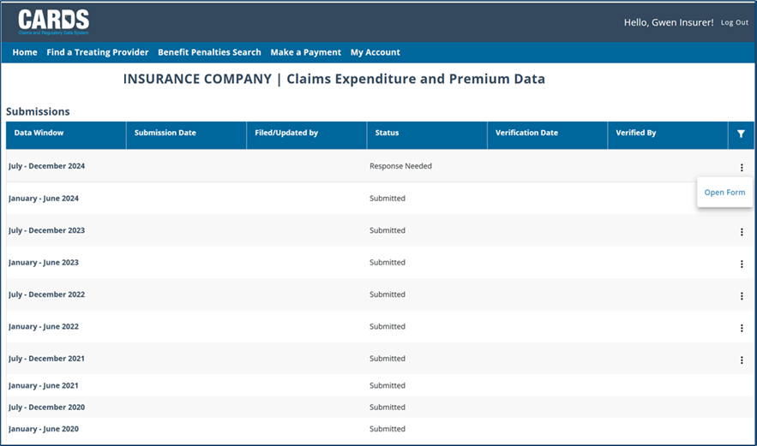
Claims Expenditure and Premium Data Page
When navigating to the webform using the link in the Forms and Tools menu, first you will be brought to the Claims Expenditure and Premium Data Landing Page which stores all the available data call windows for a given Insurer. The new submission will display as “Response Needed” and can be opened using the “Open Form” option in the action menu.
Note: Data was migrated from the legacy system, so you will notice the Submission Date and Filed/Updated by data will not be populated for those years
Note: Edit functionality is only available for the previous 3 years' worth of submissions

Slide 11
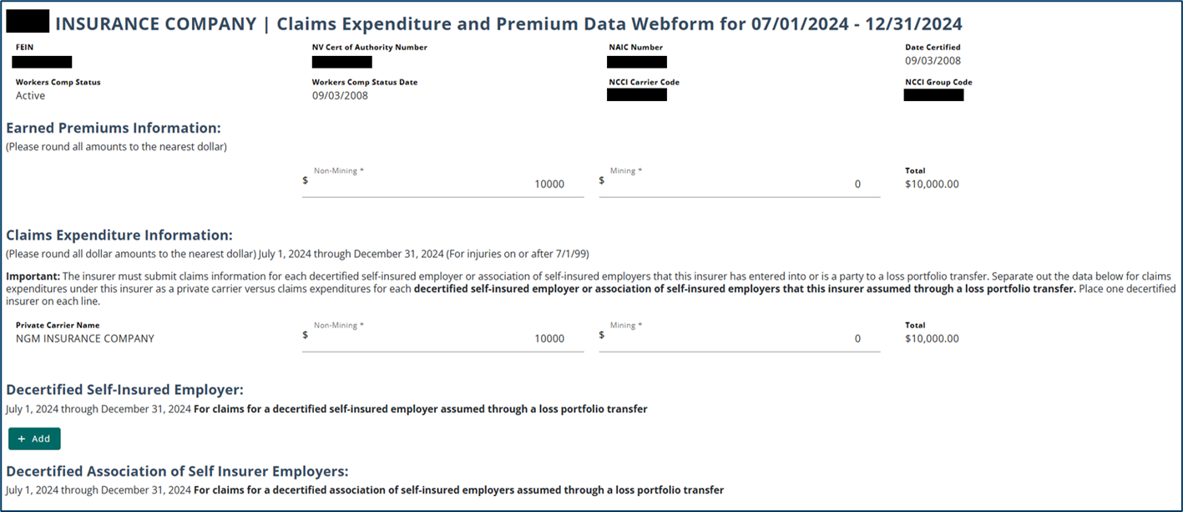

Claims Expenditure and Premium Data Webform
PRIVATE CARRIER WEBFORM
The Claims Expenditure and Premium Data Webform displays insurer information and includes fields to enter information for earned premiums and claim expenditures. Private carriers can submit claims expenditure information for decertified self-insured employers and/or decertified associations of self insurer employers.

Slide 12
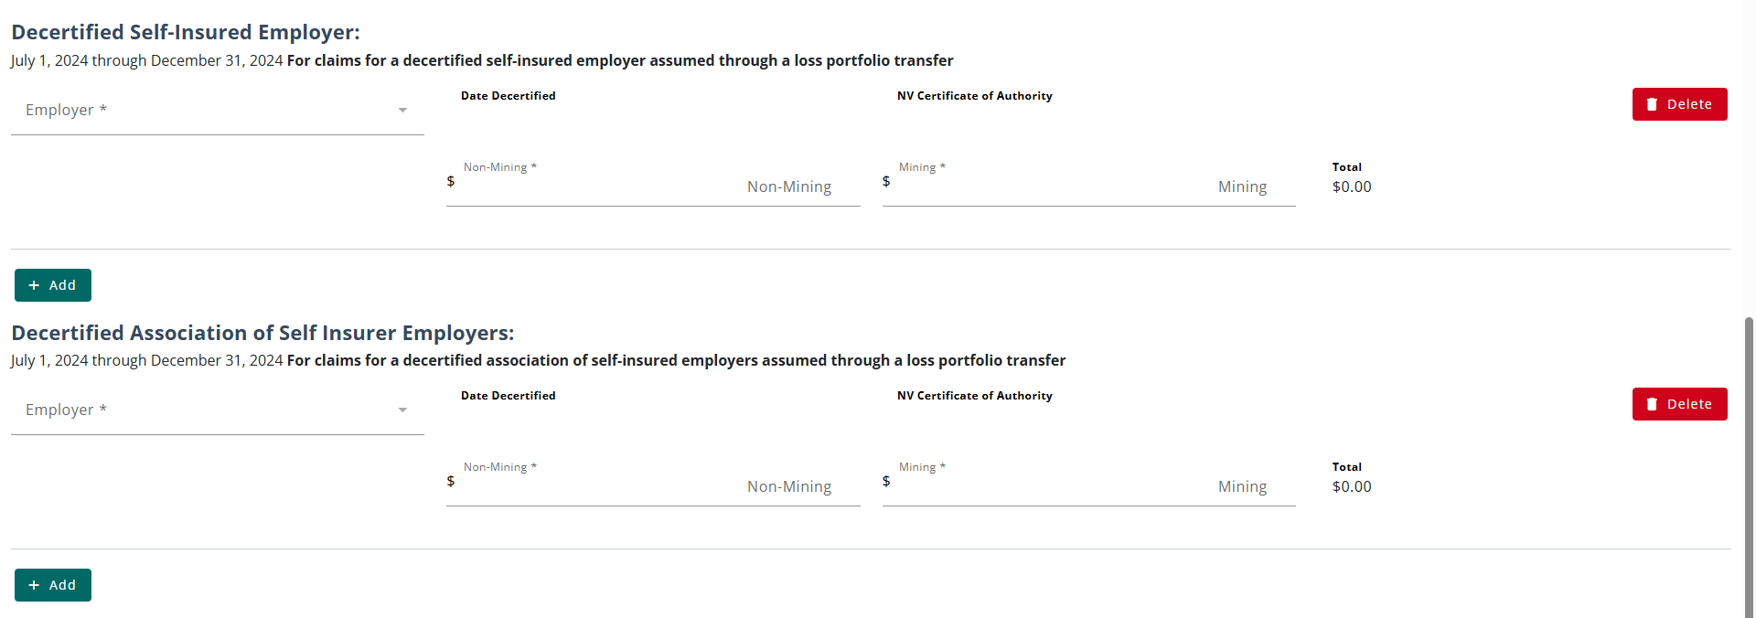
Additional Sections for Private Carriers
DECERTIFIED SELF-INSURED EMPLOYER & DECERTIFIED ASSOCIATION OF SELF INSURER EMPLOYERS
By selecting the Add button in the Decertified Self-Insured Employer or Decertified Association of Self Insurer Employers sections, users can add information for each employer record, as necessary.

Slide 13
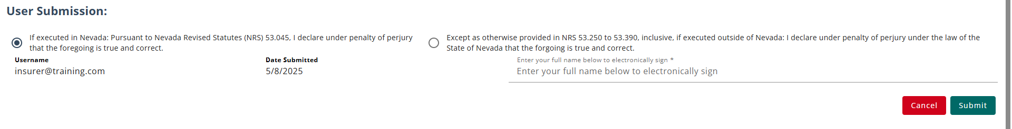
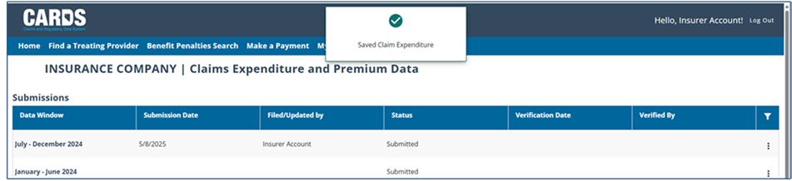
Submitting the Webform
Before submitting the webform, users must declare the information submitted is correct. Once the form is submitted, the user is brought back to the Claims Expenditure and Premium Data Page, and the status of the form will update to ‘Submitted’.

Slide 14
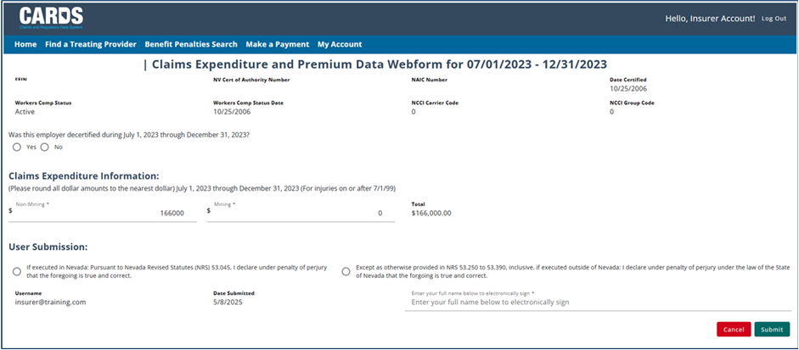
Claims Expenditure and Premium Data Webform
SELF-INSURED EMPLOYER/ASSOCIATION WEBFORM
The Claims Expenditure and Premium Data Webform for Self-Insured Employers and Association of Self-Insured Employers only collects claims expenditure data.

Slide 15
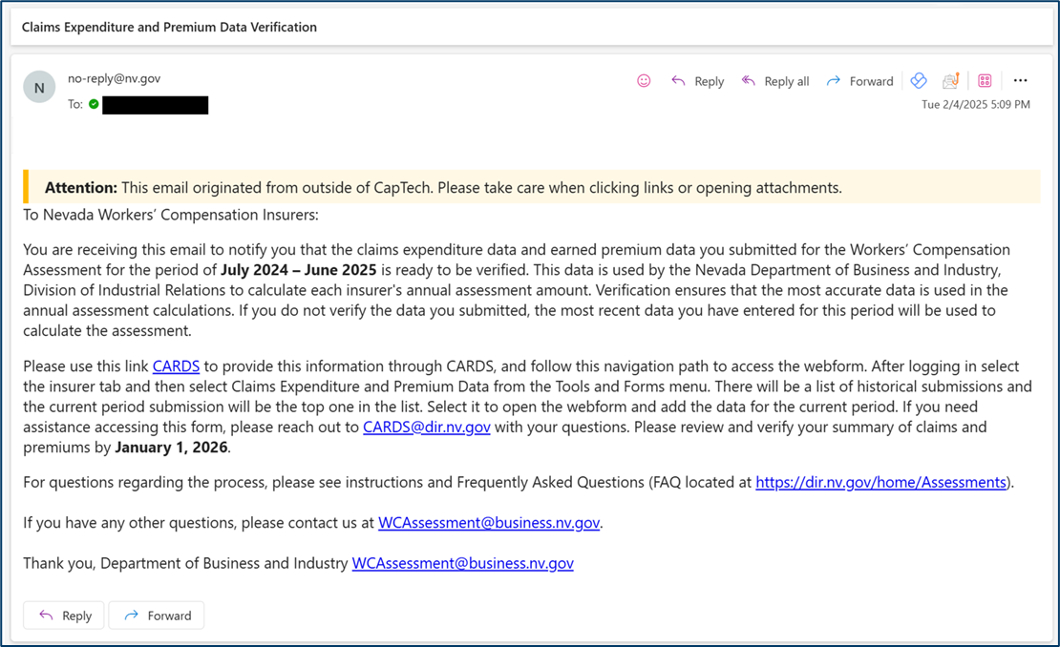
Claims Expenditure and Premium Data Verification Email
After data has been submitted, the data must be verified. Notification will be sent to all Insurers on October 31st requesting to verify the data that had been submitted for the previous fiscal year. The verification window will be open until January 1st.

Slide 16
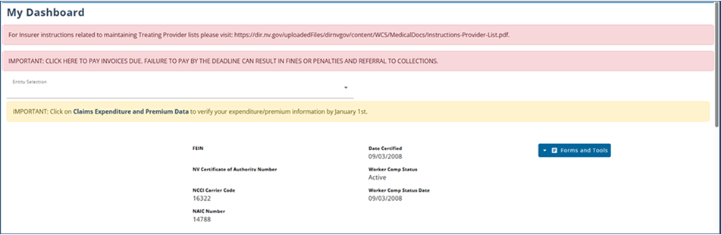
Verifying the Claims Expenditure and Premium Data Filing
VERIFICATION REMINDER
When the verification window is active, a message will be displayed on the user's external homepage.

Slide 17
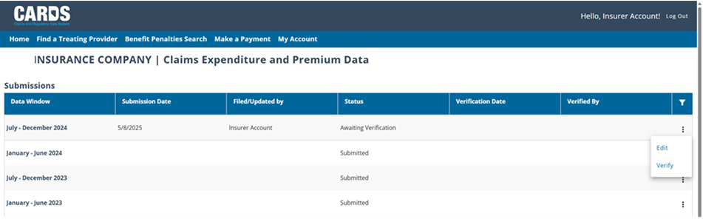
Verifying the Claims Expenditure and Premium Data Filing
ACCESSING THE VERIFICATION FORM
You can fill out the verification form by selecting “Verify” in the action menu on a Data Window with an Awaiting Verification status.

Slide 18
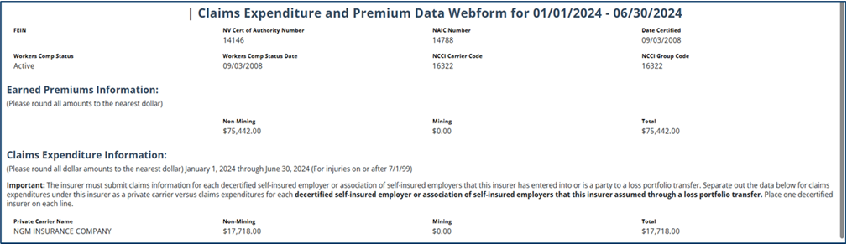
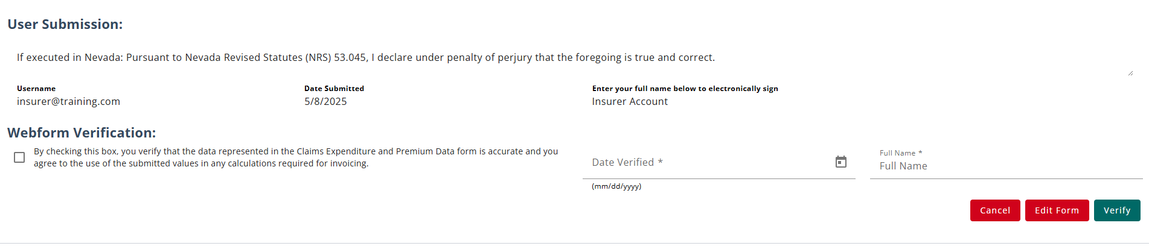
Verifying the Webform
The top of the webform is available as read-only to review submitted information. If you feel any of the information needs to be changed before you verify, the Edit Form button will take you back to the editable version of the form.

Slide 19
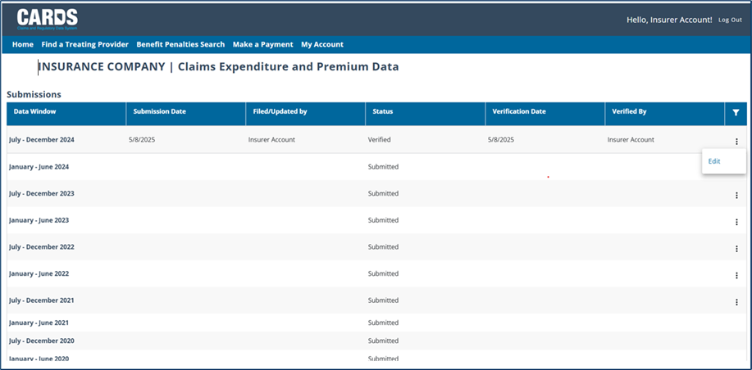
Confirming Verification
After the verification is complete, the status of the submission will update to Verified and the action menu will no longer have Verify as an option.

Slide 20
Important Dates to Note for the Assessment Process
Estimated Assessment
    Sept 30 Invoice Emailed
    Dec 1- first installment due
        Jan 5- email sent if no payment
        Jan 12- delinquent letter mailed
        Jan 22- referral for collections and penalties if no payment
    Jan 1- 2nd installment due
    Feb 1- 3rd installment due
    Mar 1- 4th installment due
Final/COLA Assessment
    May 31 Invoice Emailed
    June 30 Final and COLA assessment due or refunds paid
        August 5- email sent if no payment
        August 22- referral for collections and penalties if no payment
    Data Calls for Claims Expenditure and Premium Data
      Jan 31 email requesting data for previous July- Dec
      July 31 email requesting data for previous Jan- June
      Oct 31 request for verification of data emailed
      Jan 1 verification process ends

Slide 21
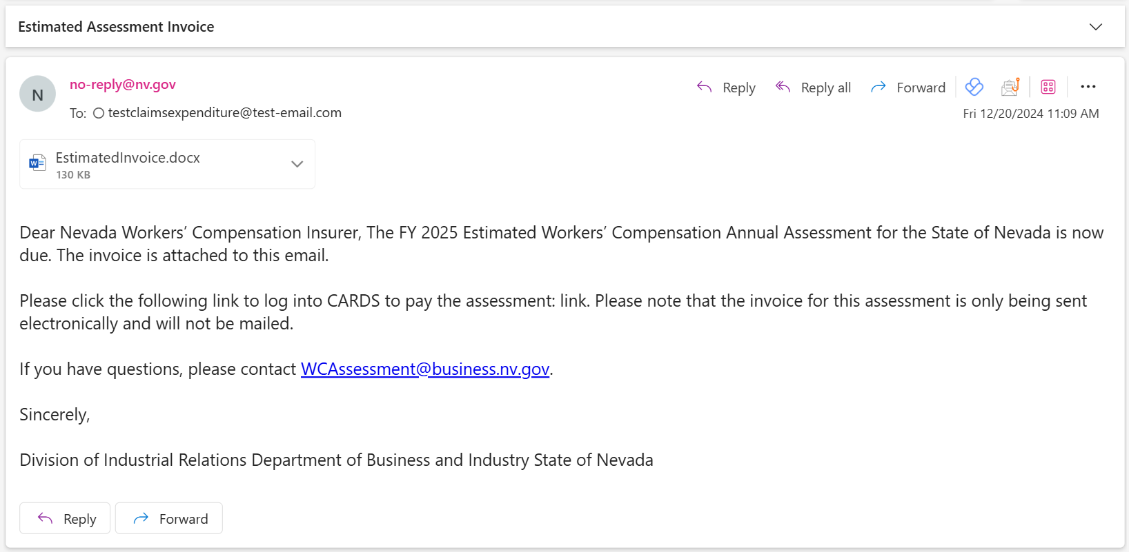
Notification of Invoice Due
Once the internal process of calculating the Estimated, Final, and COLA assessment occurs, invoices will be generated, and Insurers will be notified of the assessment payment via email.

Slide 22
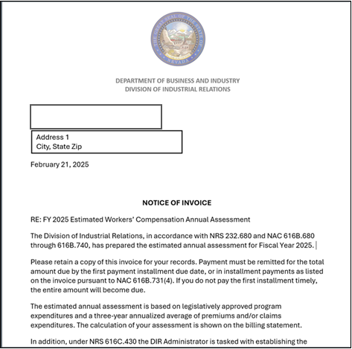
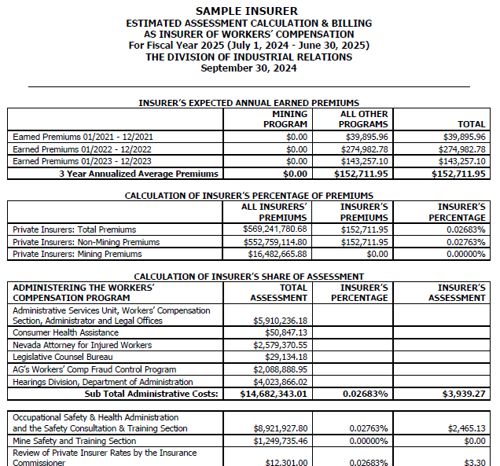
Notification of Invoice Due
The invoice attached to the email will include the cover letter and invoice for the associated assessment.
Insert dummy invoice here

Slide 23
Questions?
Claims Expenditure and premium data reporting
WCS staff is here to help! For any issues that arise pertaining to the new assessment process in CARDS, you will direct your questions to WCSRA@dir.nv.gov.
All other assessment related questions should be directed to wcassessment@business.nv.gov.
Notes:
Note: Replace the date placeholder with the date of the presentation to stakeholders and update contact information as necessary

